Slide 1
A Star Algorithm
Lab 2
Bijoy Singh (120050087)
Sai Kiran Mudulkar(120050068)
Manik Dhar(120050006)

Slide 2
LAB 02 Problem Statement
1. Demonstrate the utility of Monotone Restriction
2. Carry out bidirectional A* search S-->G and G-->S; is there any advantage? The search stops when the two searches meet at a common node.

Slide 3
Non Monotonic Heuristic
We used the following method to generate a non monotonic heuristic. Let say we have a monotonic heuristic h available to us. We define a new heuristic hʼ as follows:
hʼ = h if the blank tile is not in the first column
= 0 otherwise
hʼ is a non monotonic heuristic for the 8 puzzle.

Slide 4
Non Monotonic Heuristic
Now for non-monotonic heuristics we expect that in some case nodes in the closed list would have to be updated.
This is observed to take place in some of the test cases as expected.

Slide 5
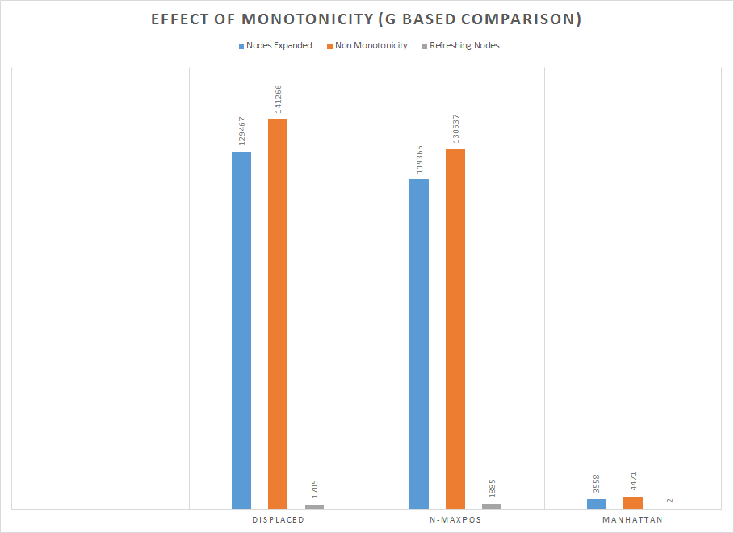

Slide 6
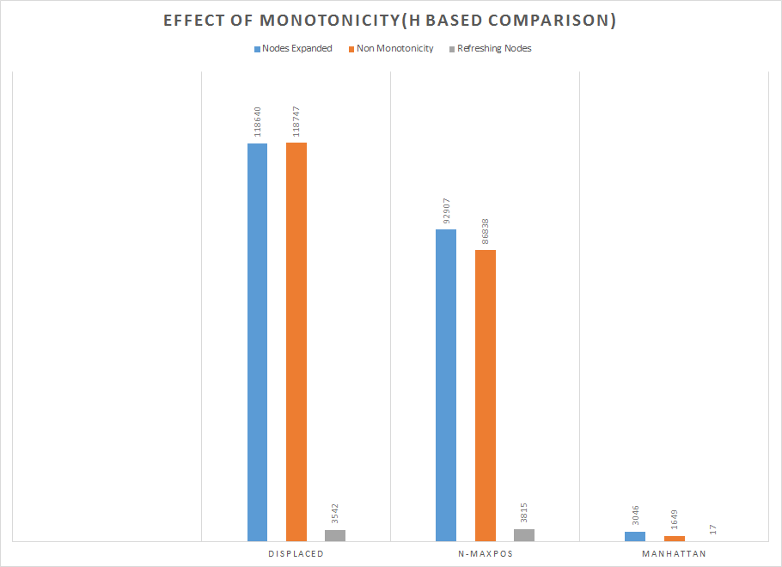

Slide 7
Bidirectional AStar
Implementation:
We use 2 Open Lists and Closed Lists based on the data structures and procedure defined in previous lab.
One open list corresponds to the forward step and the other corresponds to the backward step(from goal to the start)

Slide 8
Bidirectional AStar Contd.
Now on each step we call a step function for the forward A* (A_{for}) and backward A* (A_{bac}).
In A_{for} the g and h value are calculated with respect to the start node and in A_{bac} it is done with respect to the goal node.

Slide 9
Bidirectional AStar Contd.
If h is not equal to 0, then we will observe that bidirectional search doesn’t always give the optimal path.
If h = 0, optimality is guaranteed as was observed.
The algorithm stops when we get a common element in the closed set of A_{for} and A_{bac} .

Slide 10
Non Optimality Of Bi-A*
On smaller cases the non optimality is not so evident, but when we ran on :
5,6,7 ; 4,0,8 ; 3,2,1 to 1,2,3 ; 8,0,4 ; 7,6,5
The path length found is 33 for manhattan which is not optimal (optimal is 31, which we got for h = 0)

Slide 11
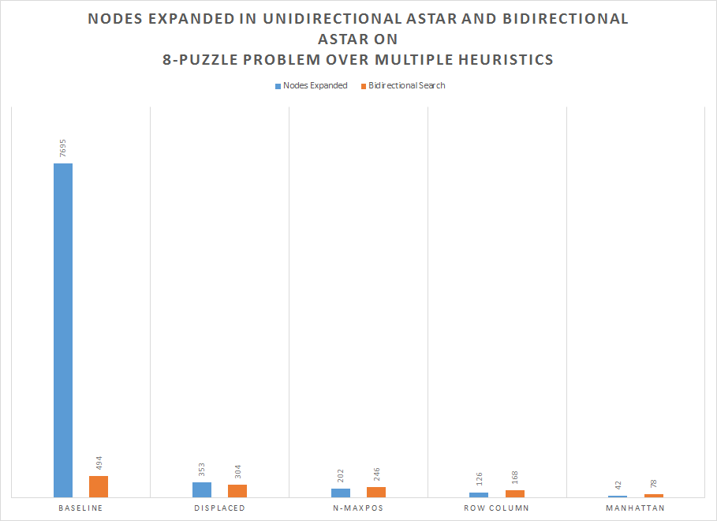

Slide 12
THANK YOU

